Slide 1

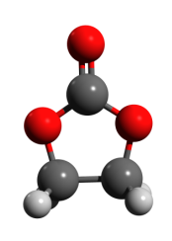
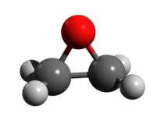
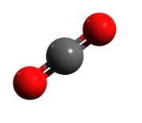

Completely Alternating Copolymerization of CO₂ and Epoxides to Polycarbonates
Donald J. Darensbourg
Texas A&M University, Department of Chemistry
djdarens@mail.chem.tamu.edu
+
+

Slide 2
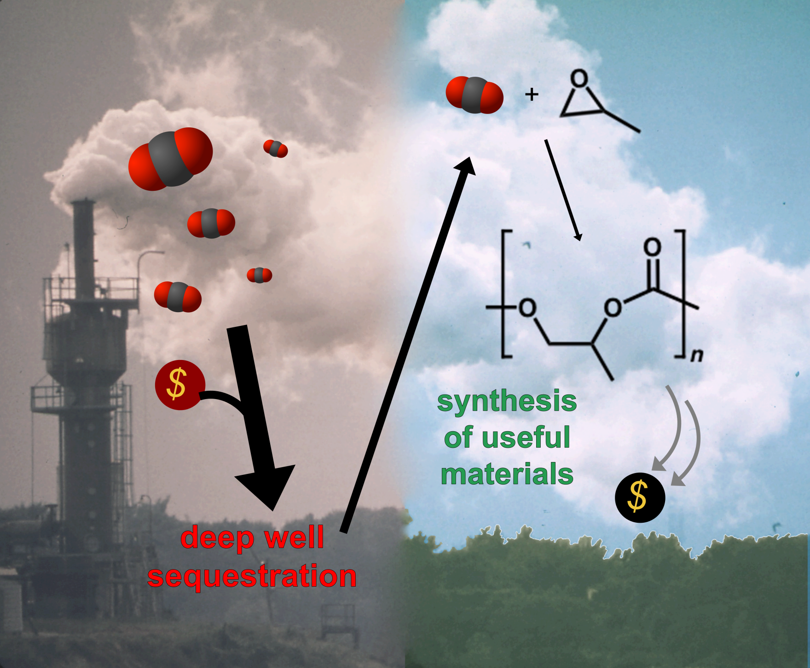

Slide 3
Greener Synthesis of Polycarbonates
No extraneous solvent required
100% atom economy
Constructive use of abundant “waste” C1 feedstock
Living polymerization
Typical Catalytic System: (salen)M(III)X with onium salt cocatalyst
PPNX
nBu₄NX
Robust, tetradentate* ligand
Activity/Selectivity tunable by altering
R₁, R₂, R₃, M, X
Typical System: M = Cr, Co
R₁ = R₂ = ^{t}Bu
R₃ = -C₂H₄-, cyclohexyl
Darensbourg, D. J. Chem. Rev. 2007, 107, 2388-2410.
Darensbourg, D. J., Wilson, S. J. Green Chem. 2012, 14, 2665–2671..

Slide 4
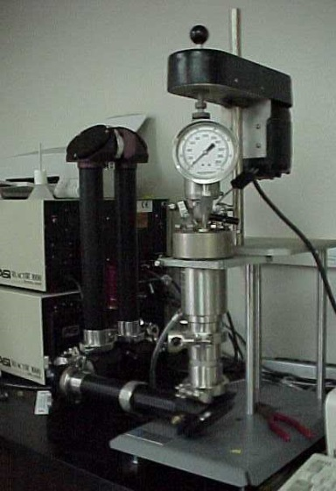
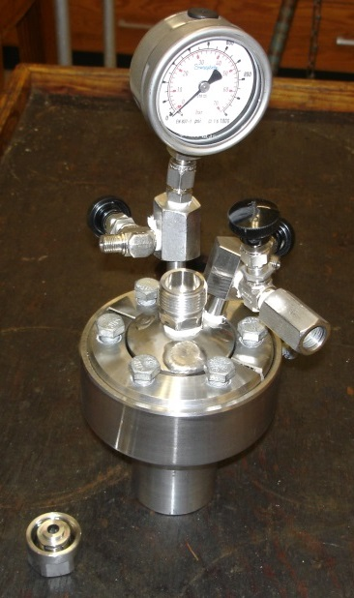
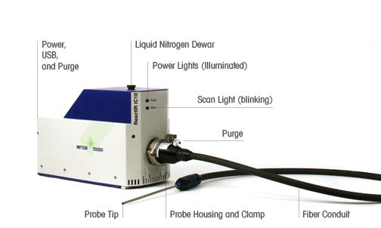
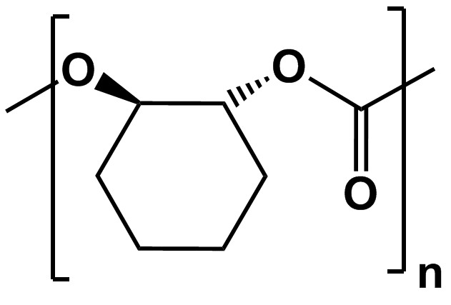
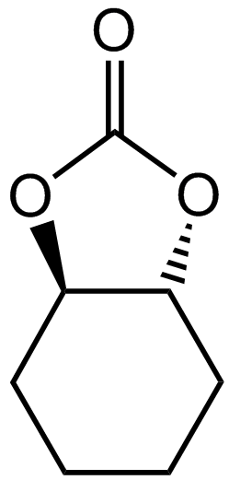
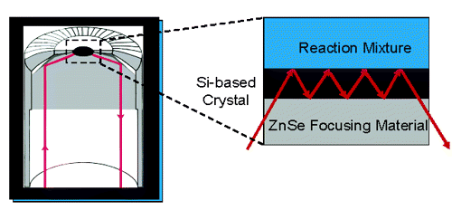
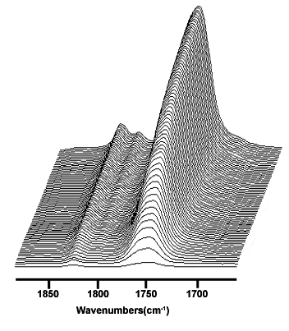
Monitoring Polymerization Kinetics – in situ ATR FT-IR
probe
1750 cm⁻¹
argon,
vacuum
CO₂ inlet
reactants inlet
CO₂ inlet
argon,
vacuum
//
reactants inlet
jacketed heating mantle
Solution becomes too viscous at this point.
//
crystal
1810 cm⁻¹
1802 cm⁻¹
ASI® ReactIR 1000
ReactIR™ ic10
Excellent for reactions run with at
least 12 mL at temperatures ≥ 25 ºC.
Small high-pressure reactor designed in-house.
Manages well with small scale reactions (< 5 mL).
System can be heated or cooled to any practical temperature.
Absorbance
Time
Time (h)
Attenuated Total Reflectance
Infrared Spectroscopy
Wavenumbers(cm⁻¹)

Slide 5

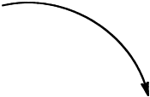


Coupling Mechanism
See review: Darensbourg, D. J.; Yeung, A. D.
Polymer Chemistry 2014, 5, 3949—3962.

Slide 6
Routes to Cyclic Carbonates
Metal free pathway has much lower kinetic barrier.

Slide 7
Copolymerization of Styrene Oxide and Carbon Dioxide
Thermal stability up to 300 ºC and Tg = 80 ºC
25 ºC, TOF = 75 h⁻¹ @ 2.0 Mpa CO₂ Selectivity PSC:SC of 99:1
PPNX as cocatalyst
Wu, G.-P.; Wei, S.-H.; Lu, X.-B.; Ren, W.-M.; Darensbourg, D. J. Macromolecules 2010, 43, 9202.
Wu, G.-P.; Wei, S.-H.; Ren, W.-M.; Lu, X.-B.; Li, B.; Zu, Y.-P.; Darensbourg, D. J. Energy & Environmental Sci. 2011, 4, 5084-5092.

Slide 8
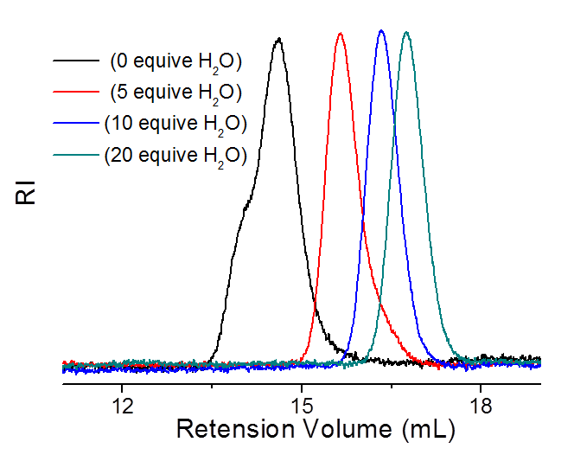
Rapid and Reversible Chain Transfer Processes
Mn (g/mol)
16800
11000
6800
4200
(0 equiv H₂O)
(5 equiv H₂O)
(10 equiv H₂O)
(20 equiv H₂O)
Bimodal Distribution of Molecular Weights

Slide 9
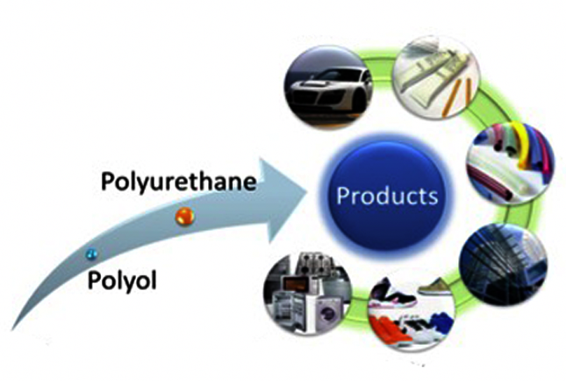
Polyether Polyols
Adhesives,
Sealants &
Binders
Polyols currently used derived 100% from petroleum resources (polyethers).
Replaced with polycarbonate polyols derived in part (~50%) from CO₂.
Automotive
Coatings &
Elastomers
Building &
Construction
Feedstocks
Appliances
Footwear
http://www.econic-technologies.com/technologies/products/polyols/

Slide 10
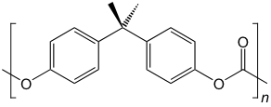
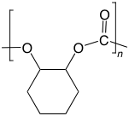
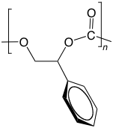
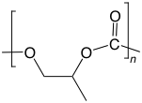
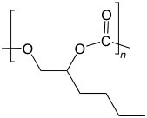
Desired Properties
?
BPA Polycarbonate
Lexan®
poly(cyclohexene carbonate)
T_{g} ≈ 115 ºC
easy to polymerize
brittle polymer
Industrial standard polycarbonate
T_{g} ≈ 150 ºC
Amorphous, robust polymer
High M_{n}’s achievable
Chain entanglement at low MW
poly(styrene carbonate)
T_{g} ≈ 80 ºC
sensitive polymerization
What conditions can we use to
produce polymers similar
to that of BPA polycarbonate?
poly(propylene carbonate)
T_{g} ≈ 40 ºC
excellent mechanical properties
industrially produced
Our Focus:
high glass transition temperature (T_{g})
poly(1-hexene carbonate)
T_{g} ≈ -15 ºC
Wu, G.-P.; Wei, S.-H.; Lu, X.-B.; Ren, W.-M.; Darensbourg, D.J. Macromolecules 2010, 43, 9202-9204.
Seong, J.E.; Na, S.J.; Cyriac, A.; Kim, B.-W.; Lee, B.Y. Macromolecules. 2010, 43, 903-908.

Slide 11
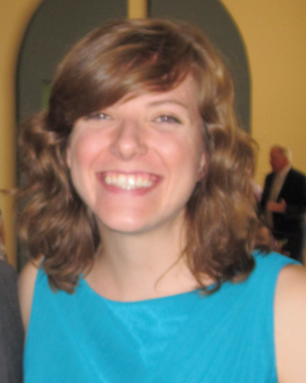
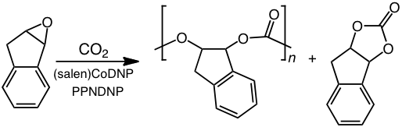
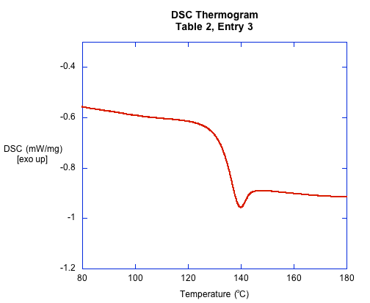
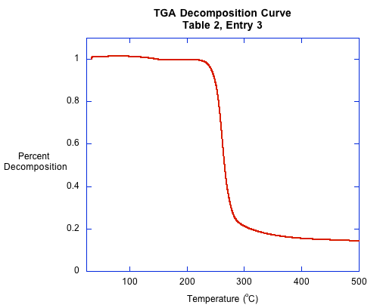
Coupling of CO₂ and Indene Oxide
Stephanie Wilson
Poly(indene carbonate)
T_{g} around 140 ºC
T_{d} ~ 249 ºC
Highest reported T_{g}
for CO₂/epoxides coupling!
Darensbourg, D.J.; Wilson, S. J. J. Am. Chem. Soc. 2011, 133, 18610-18613.

Slide 12
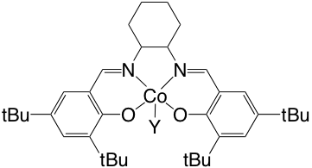
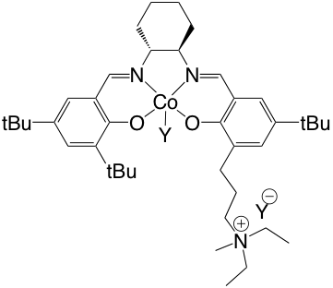

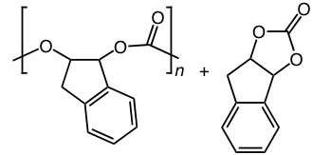
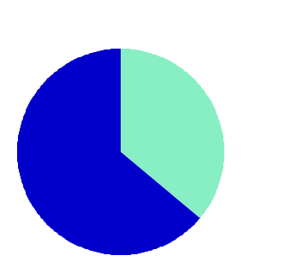

Binary vs Bifunctional Catalyst Systems
(1)
(2)
versus
Selectivity for Polymer
(1)
(2)
polymer
cyclic
Darensbourg, D.J.; Wilson, S. J. Macromolecules 2013, 46, 5929.

Slide 13
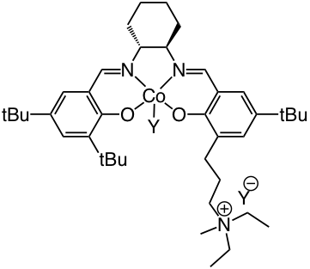
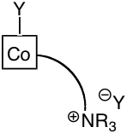
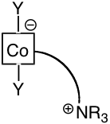

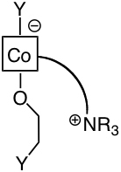
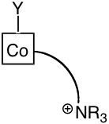
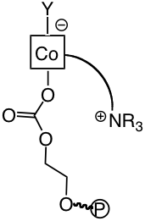
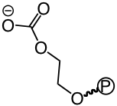
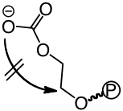

Bifunctional Catalyst System – How They Work
≡
polymer attracted
to ammonium cation
backbiting prevented
polymer detaches
backbiting to
cyclic commences
CO₂,

Slide 14
Design of New Polymeric Materials
Terpolymerization, addition of a second epoxide monomer.
Postfunctionalization of copolymers.
Diblock polymers incorporating ROP of other cyclic monomers, e.g., polycarbonate-polylactide
(NOTE: polylactides are among the few biodegradable polymers with FDA approval for human clinical use. Controlled drug delivery and tissue engineering scaffolds.)

Slide 15
Terpolymerization with Postpolymerization Functionalization
Using free-radical initiator (AIBN), add

Slide 16
Postfunctionalization of Copolymers Hybrid Polymers
Darensbourg, D. J.; Tsai, F.-T., Macromolecules, 2014, 47, 3806—3813.

Slide 17
Functionalization of Polycarbonate Films
or
cat.
terpolymerization
uv
crosslinking
uv
surface
functionalization

Slide 18
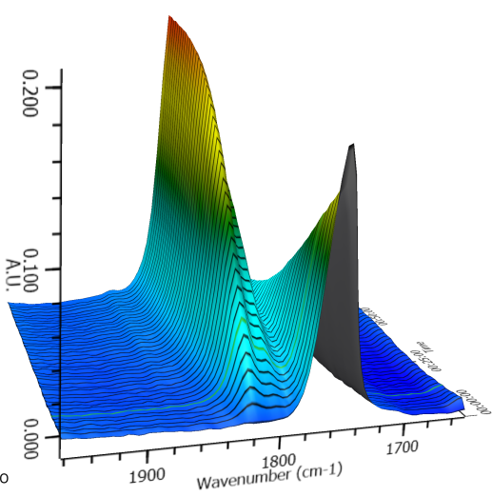
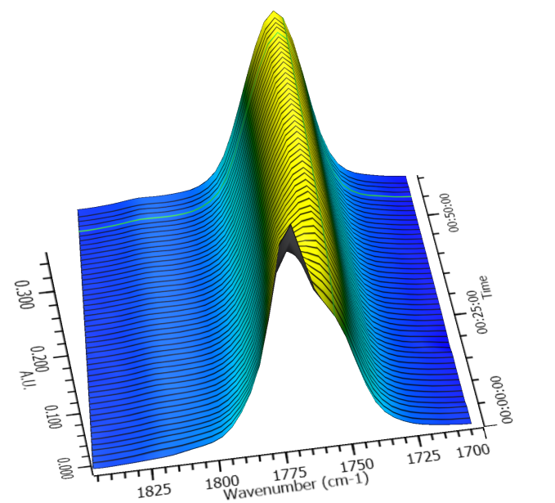
Tandem Synthesis of Poly(styrene carbonate-block-lactide)
Cyclic styrene carbonate
Poly(styrene carbonate)
PSC-block-PLA
Lactide
Cyclic styrene carbonate
Wu, G.-P.; Darensbourg, D. J.; Lu, X.-B. J. Am. Chem. Soc., 2012, 134, 17739-17745.

Slide 19
A One-Pot Synthesis of a Triblock Copolymer
from PO/CO₂ and Lactides
HO-(PPC)-OH
PLA-b-PPC-b-PLA
Darensbourg, D. J.; Wu, G.-P. Angew. Chem. Int. Ed. 2013, 52, 10602-10606.

Slide 20
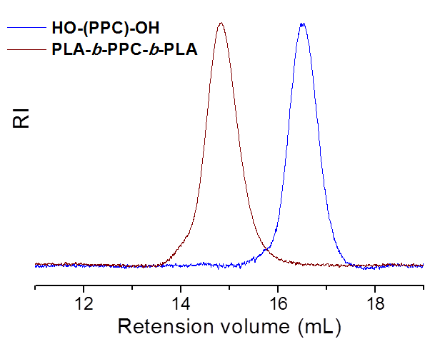
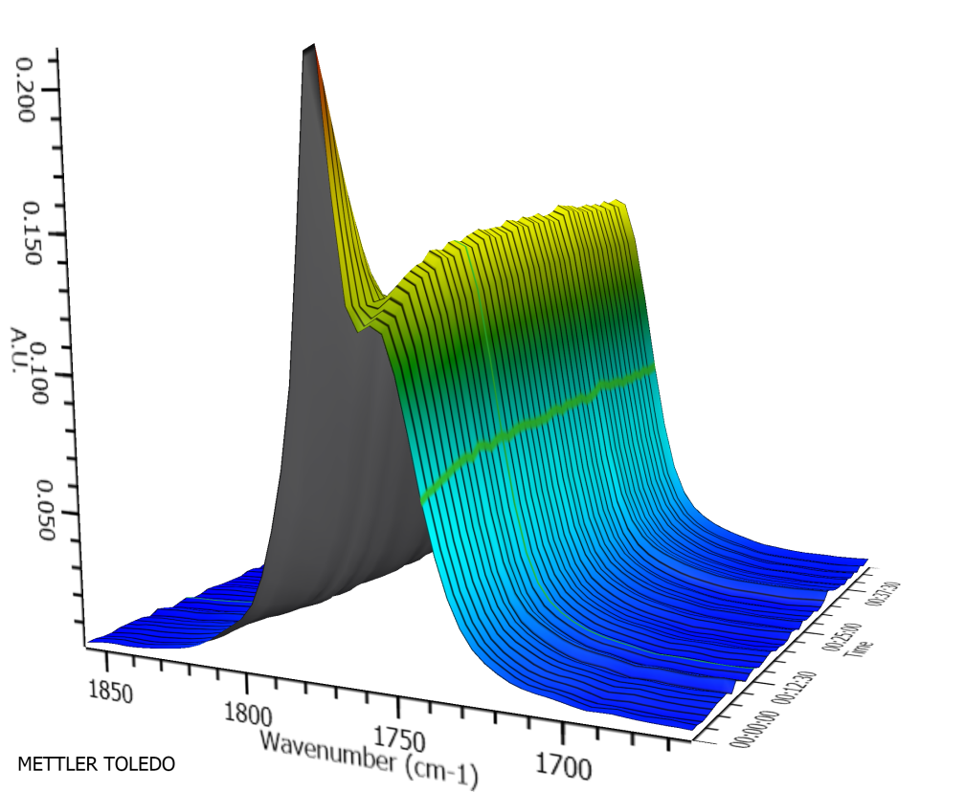
ABA Triblock Polymers

Slide 21
Darensbourg, D. J.; Chung, W.-C.; Wang, K.; Zhou, H.-C. ACS Catalysis, 2014, 4, 1511–1515.

Slide 22
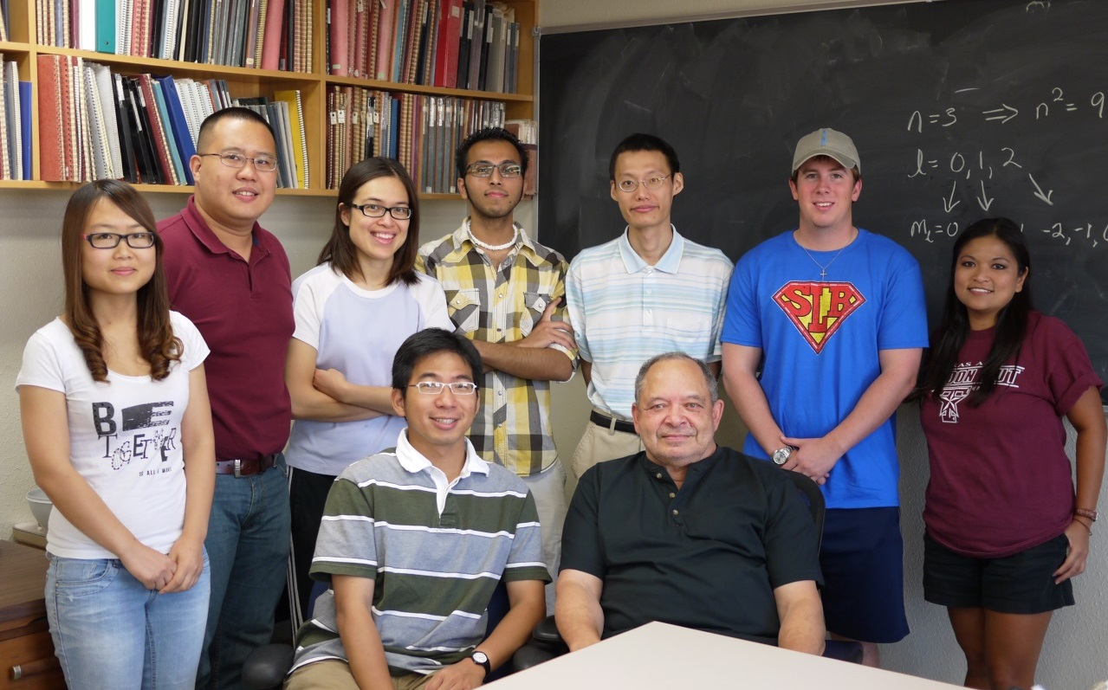

Acknowledgements
DJD Group Members:
Wan-Chun Chung
Samuel Kyran
Andrew Yeung
Yanyan Wang
Dr. Fu-Te Tsai
Dr. Rongjiao Zhu
Dr. Hamidreza Samouei
Former DJD Group Members:
Dr. Sheng-Hsuan Wei
Dr. Stephanie Wilson
Dr. Ross Poland
Dr. Osit Karroonnirun
Dr. Adriana Moncada
Dr. Wonsook Choi
Dr. Eric Frantz
Dr. Shawn Fitch
Dr. Jeremy Andreatta
Dr. Carla Rodarte
Dr. Adolfo Horn Jr.
Dr. Binyuan Liu
Dr. Bo Li
Dr. Guangpeng Wu

